Slide 1
Machine learning predictive model findings for British Airways customers
Presented by Faseni Fakoya
fasenifakoya@gmail.com
April 2024

Slide 2
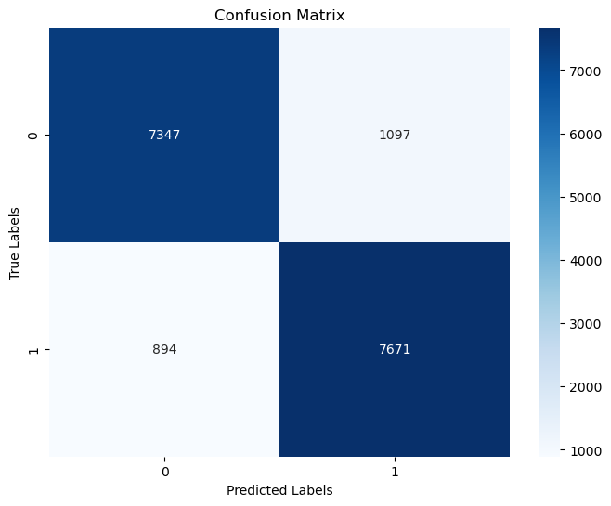
FINDINGS
The model demonstrates strong predictive performance with an accuracy and
ROC AUC score of 88%, indicating high classification accuracy and excellent
ability to predict the customers making booking. This suggests robustness in
both overall correctness of predictions and the model’s ability to rank instances
correctly across various thresholds, making it suitable for diverse
classification tasks.
Mode’s performance
88% Accuracy and ROC AUC Score
Model used: RandomForestClassifier

